Slide 1


Integrated Capstone Project
Black Friday Retail Data Analytics
Theola Lois Keren
Kanishka
Aravinth
Santhosh Velan
Beryl Joanna

Slide 2
Introduction
OBJECTIVE : Analyse customer purchase behaviour during black Friday to identify trends and marketing opportunities.
SIGNIFICANCE : Understand how factors influence spending patterns in a competitive retail environment.
FOCUS : Explore product categories, Customer segments and potential strategies for personalized marketing.
DATA SOURCE : Utilize customer purchase summary data from ‘ABC Private Limited’ for insights and analysis.
Data Overview
Data Cleaning
EDA
Visualization
Model Build
Deployment
Conclusion

Slide 3
Introduction
The analysis utilizes two datasets to capture customer demographics and their purchasing behavior during Black Friday.
By integrating these datasets, we aim to identify trends and patterns that inform targeted marketing strategies and improve customer engagement.
Data Overview
Data Cleaning
EDA
User_Demograph.csv
User_ID
Product_ID
City_Category
Stay_In_Current_City_years
Marital_Status
Product_Category_1
Product_Category_2
Product_Category_3
Purchase
User_Product_Purchase.csv
User_ID
Gender
Age
Occupation
Visualization
Model Build
Deployment
Conclusion

Slide 4
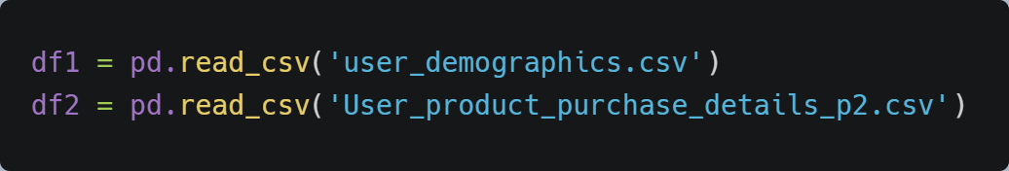
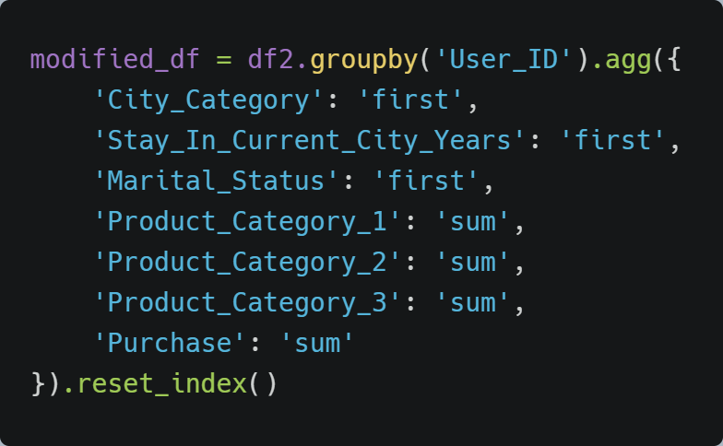
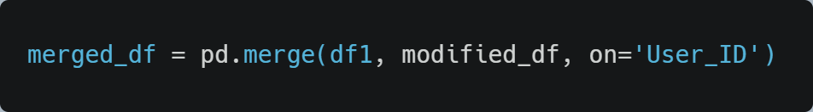
Introduction
Step 1 : Importing the CSV files.
Data Overview
Step 2 : Grouping the ‘User_Product_Purchase.csv’ on ‘User_ID’.
Data Cleaning
EDA
Visualization
Model Build
Deployment
Step 3 : Merging the two data frames.
Conclusion

Slide 5
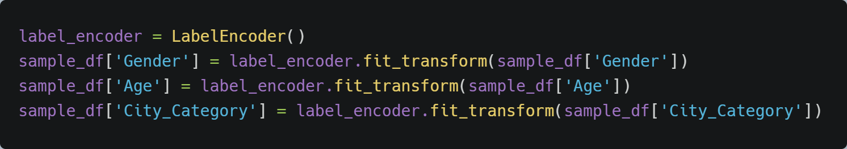
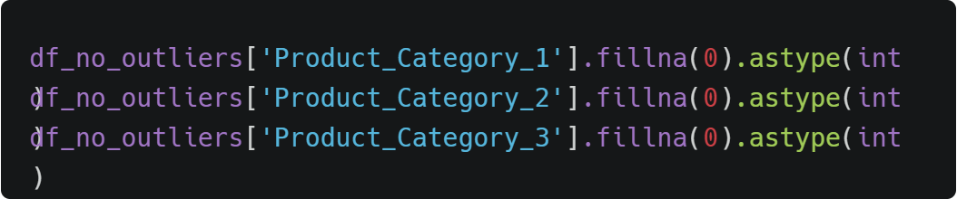
Introduction
Step 4 : Label Encoding and Mapping.
Data Overview
Data Cleaning
Step 5 : Filter out the outliers.
EDA
Visualization
Step 6 : Feature engineering /Data type modification.
Model Build
Deployment
Conclusion

Slide 6
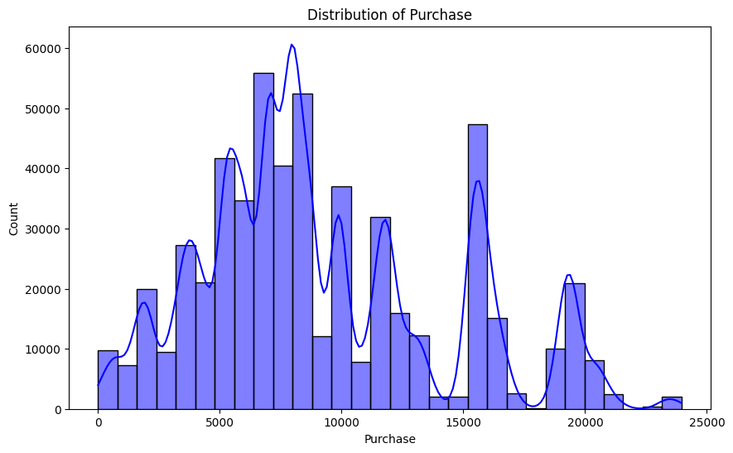
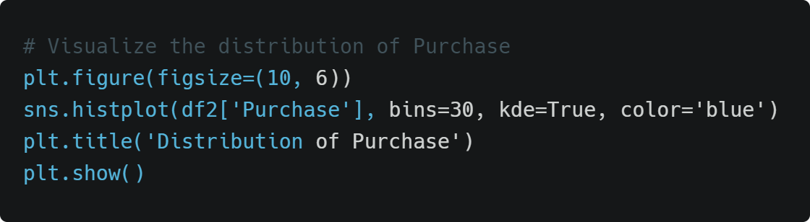
Uni Variate Analysis
Introduction
Data Overview
Data Cleaning
EDA
Visualization
Model Build
Deployment
Conclusion

Slide 7
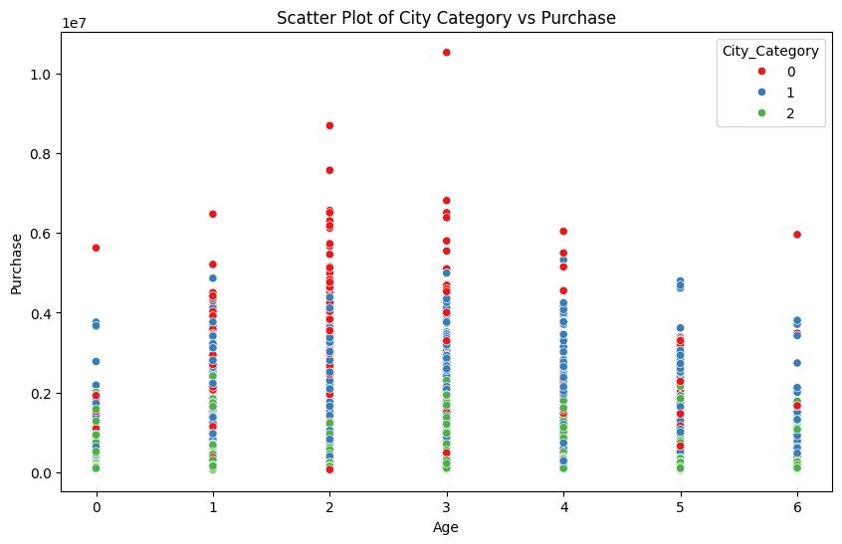
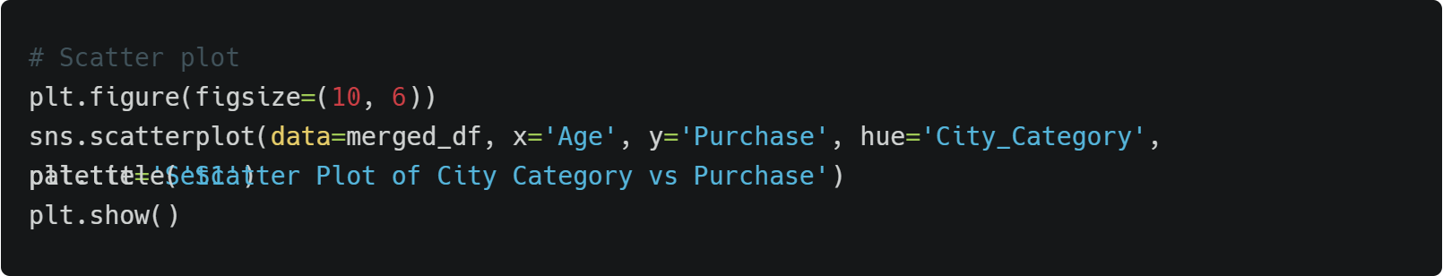
Bi Variate Analysis
Introduction
Data Overview
Data Cleaning
EDA
Visualization
Model Build
Deployment
Conclusion

Slide 8
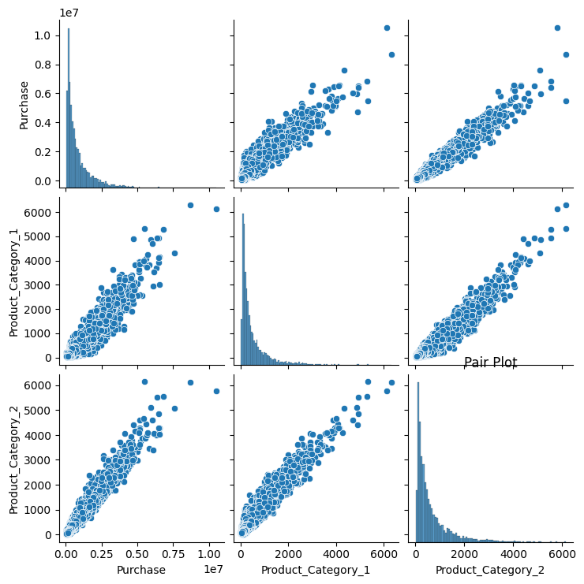
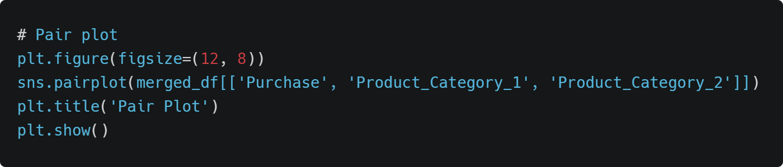
Multi Variate Analysis
Introduction
Data Overview
Data Cleaning
EDA
Visualization
Model Build
Deployment
Conclusion

Slide 9
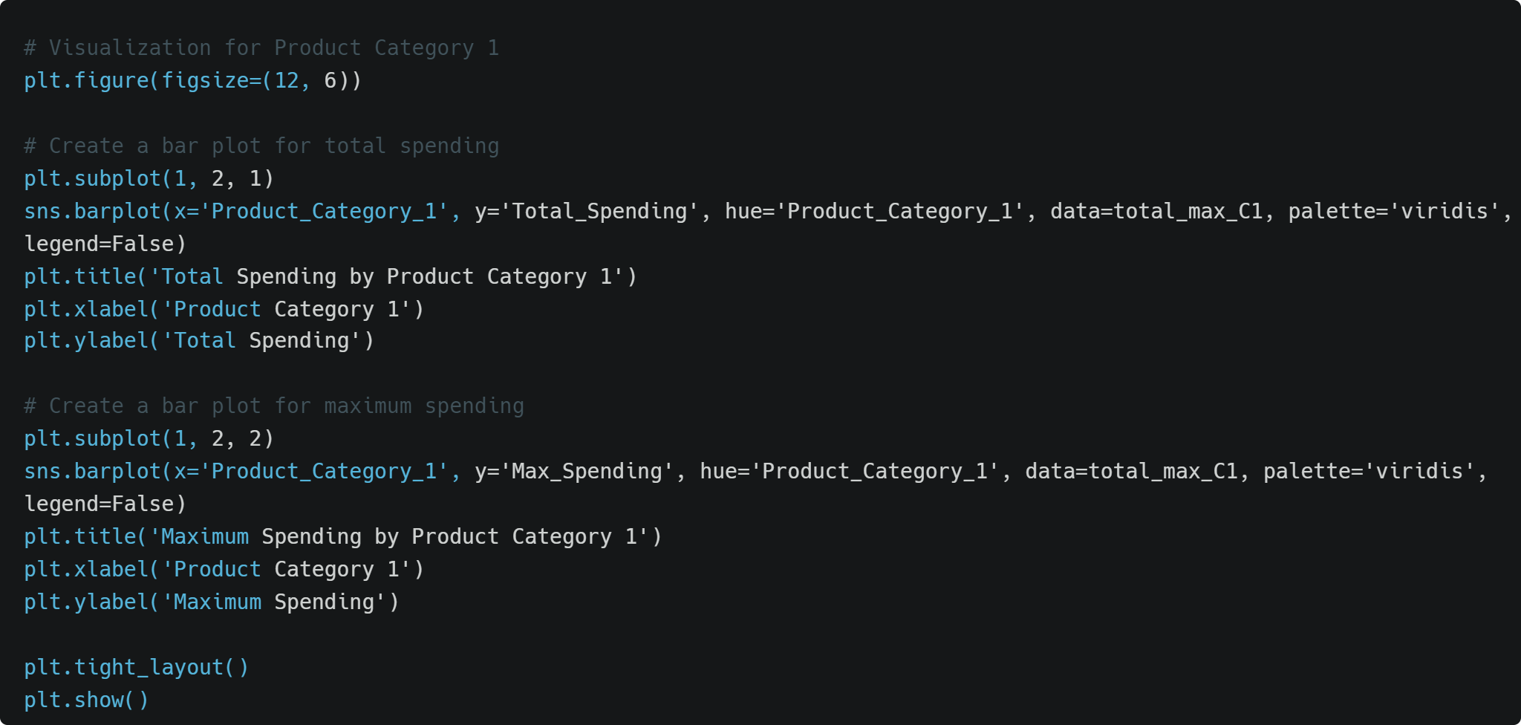
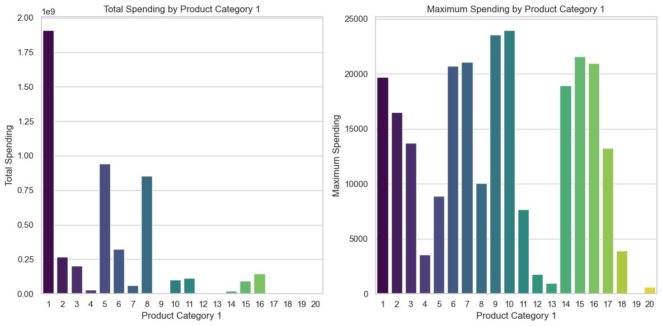
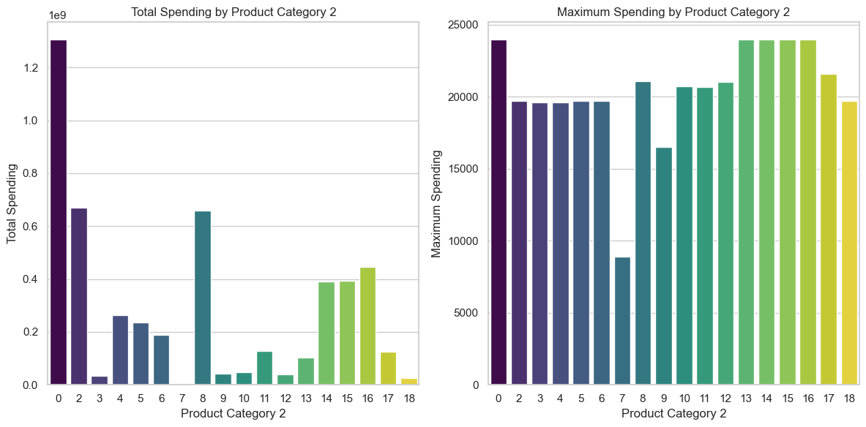
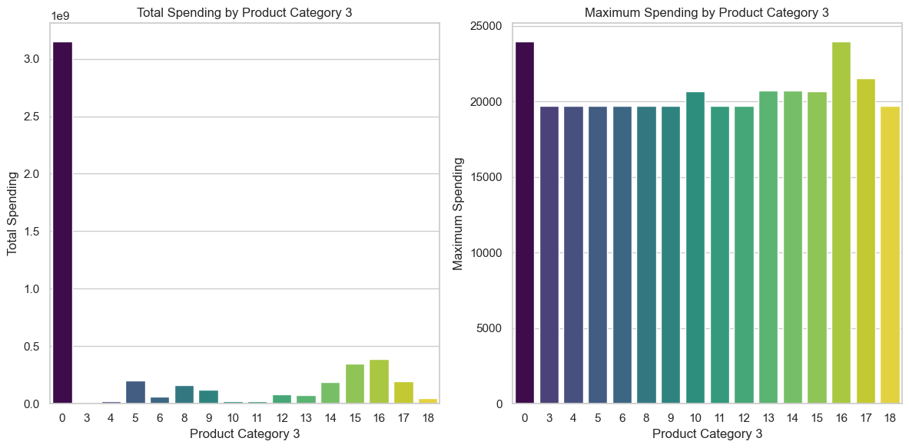
1. Maximum, spend in different categories of products
Introduction
Data Overview
Data Cleaning
EDA
Visualization
Model Build
Deployment
Conclusion

Slide 10
1.1. Maximum, spend in Product Category 1
Introduction
Data Overview
Data Cleaning
EDA
Visualization
Model Build
Deployment
Conclusion

Slide 11
1.2. Maximum, spend in Product Category 2
Introduction
Data Overview
Data Cleaning
EDA
Visualization
Model Build
Deployment
Conclusion

Slide 12
1.2. Maximum, spend in Product Category 3
Introduction
Data Overview
Data Cleaning
EDA
Visualization
Model Build
Deployment
Conclusion

Slide 13
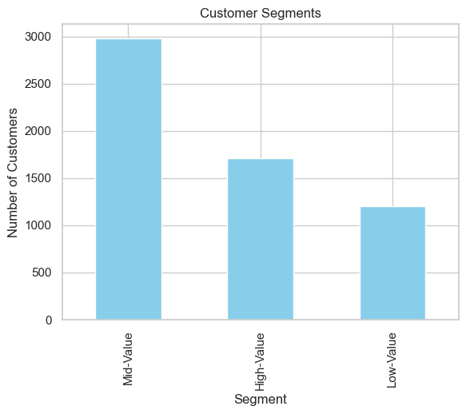
2. Customers that can be Offered Personalized Discounts
Introduction
Data Overview
Data Cleaning
EDA
Visualization
Model Build
Deployment
High Value : If the company wishes to strengthen loyalty and encourage repeat purchase.
Low Value : Discounts for this group can incentivize larger purchase and boost them to continue shopping
Conclusion

Slide 14
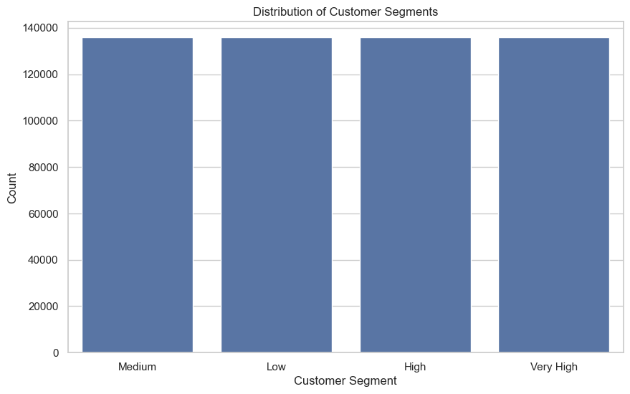
3. In which Category the Voucher should be offered
Introduction
Data Overview
Data Cleaning
EDA
Visualization
Model Build
Deployment
The customers are segregated into ‘Medium’, ‘Low’, ‘High’ and ‘Very High’ wrt purchase amount and discounts are given respectively.
Conclusion

Slide 15
4. Statistical Analysis
Introduction
Target variable -purchase amount- ranges from 12 to 23,961, with a mean purchase of ₹9,264.
The data appears to be skewed toward higher values as the 75th percentile (₹12,054) is much larger than the median (₹8,047)
This shows a long tail with high purchases
The high standard deviation of ₹5,023 suggests a wide variation in purchase amounts
Most Purchased Product P00265242 - was bought 1,880 times
Category B has the highest frequency, with 231,173 purchases
The most frequent Stay in current city is 1 year, with 193,821 users- indicates that a large number of customers are relatively new to their cities
Strong male-dominated customer base - 414,259 or 75% of the total
Majority of the customers fall into the young adult demographic - 26-35 age range, 219,587 users - 40% of Total
Most customers spend between ₹5,823 and ₹12,054, based on the IQR
Data Overview
Data Cleaning
EDA
Visualization
Model Build
Deployment
Conclusion

Slide 16
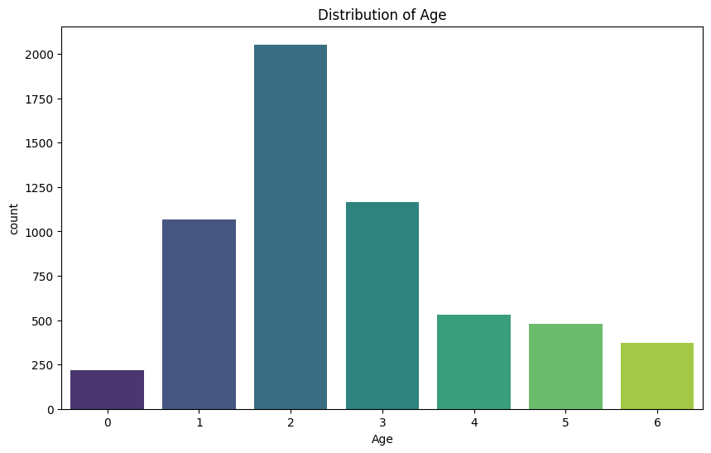
Introduction
Visualizing Distribution of Age
Data Overview
Data Cleaning
EDA
Visualization
Model Build
Deployment
Conclusion

Slide 17
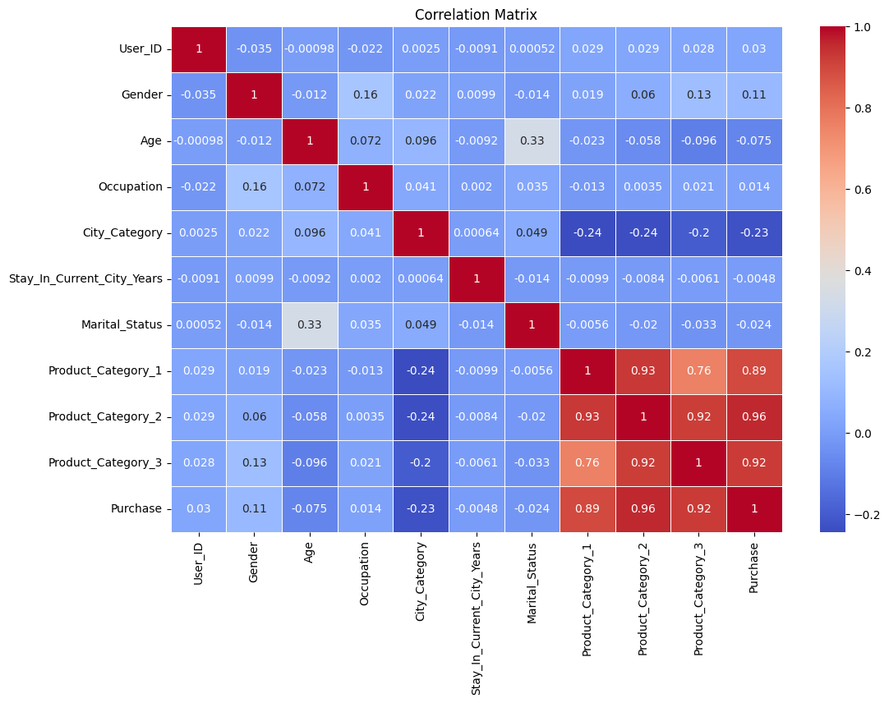
Introduction
Correlation Matrix
Data Overview
Data Cleaning
EDA
Visualization
Model Build
Deployment
Conclusion

Slide 18
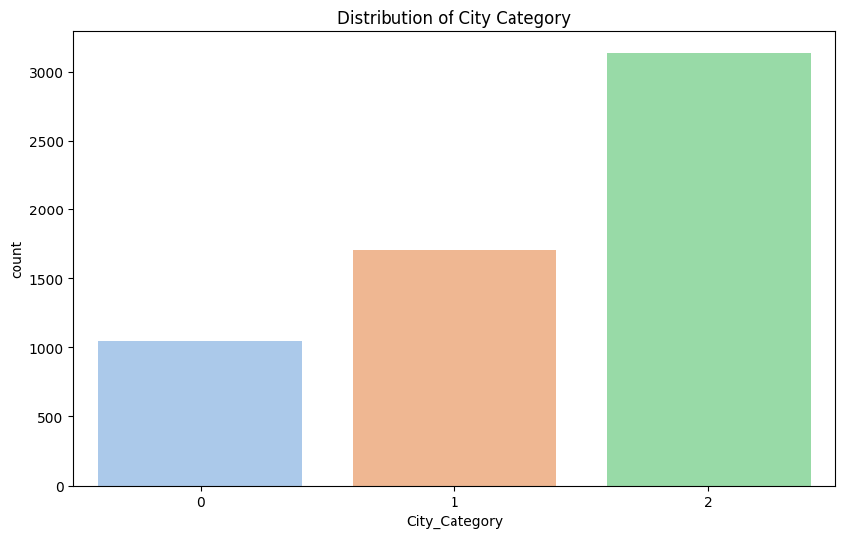
Introduction
Distribution of City Category
Data Overview
Data Cleaning
EDA
Visualization
Model Build
Deployment
Conclusion

Slide 19
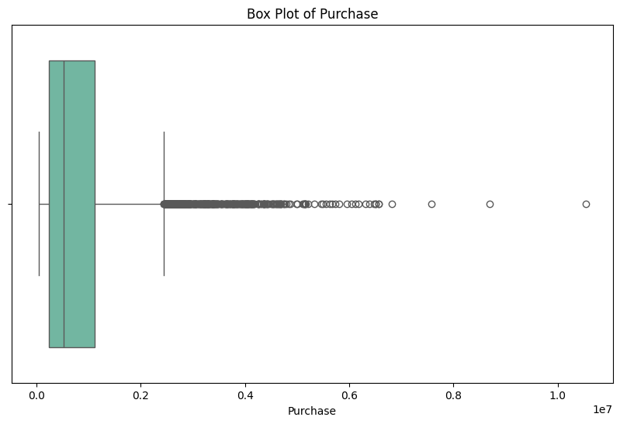
Introduction
Outliers Identification
Data Overview
Data Cleaning
EDA
Visualization
Model Build
Deployment
Conclusion

Slide 20
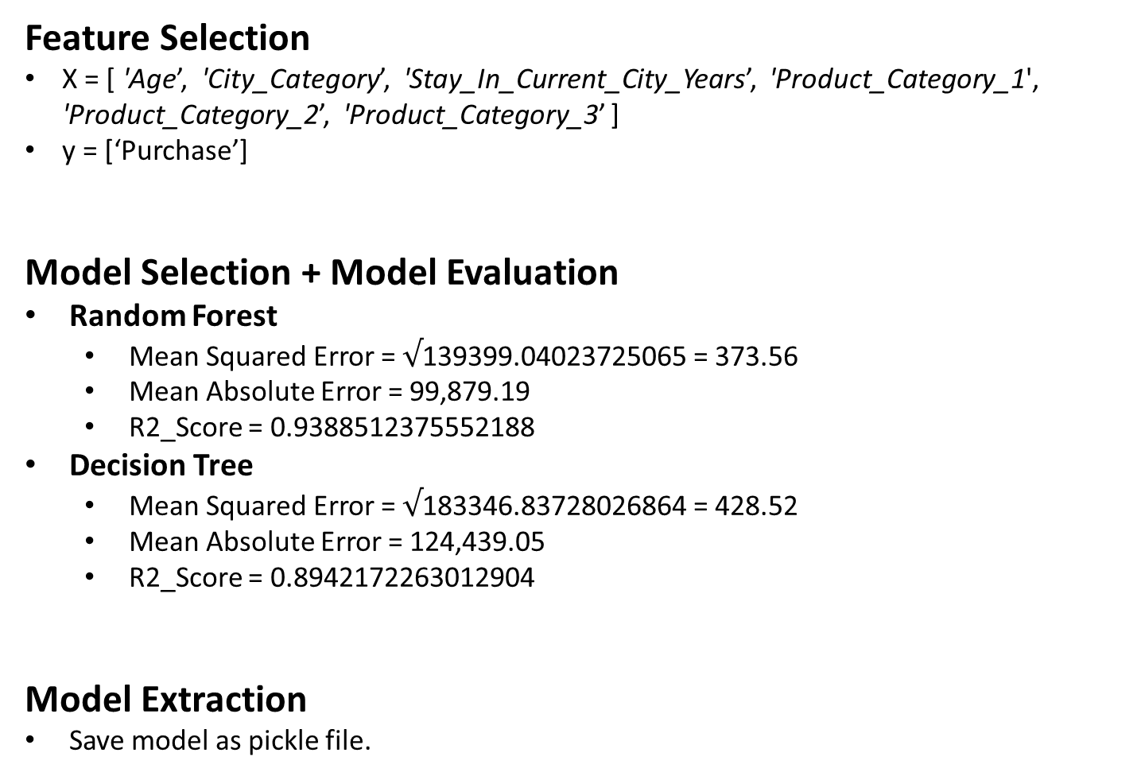
Feature Selection
X = [ 'Age’, 'City_Category’, 'Stay_In_Current_City_Years’, 'Product_Category_1', 'Product_Category_2’, 'Product_Category_3’ ]
y = [‘Purchase’]
Model Selection + Model Evaluation
Random Forest
Mean Squared Error = $√$139399.04023725065 = 373.56
Mean Absolute Error = 99,879.19
R2_Score = 0.9388512375552188
Decision Tree
Mean Squared Error = $√$183346.83728026864 = 428.52
Mean Absolute Error = 124,439.05
R2_Score = 0.8942172263012904
Model Extraction
Save model as pickle file.
Introduction
Data Overview
Data Cleaning
EDA
Visualization
Model Build
Deployment
Conclusion

Slide 21
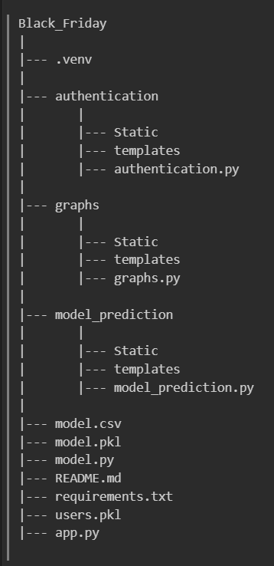
Framework : Flask (Application)
Model Serialization: Pickle
API Endpoints
/predict
/graphs
/abouts
File Extraction (Extract model training file)
PDF
ipynb
HTML
Markdown
Introduction
Data Overview
Data Cleaning
EDA
Visualization
Model Build
Deployment
Conclusion

Slide 22
Introduction
Objective : Build and deploy a Machine Learning model to predict user purchase behavior.
Key Steps :
Data processing
Data cleaning
Data visualization
Model Building
Model extraction
Deployment
Data Overview
Data Cleaning
EDA
Visualization
Model Build
Deployment
THANK YOU
Conclusion

